Slide 1
﷽

Slide 2
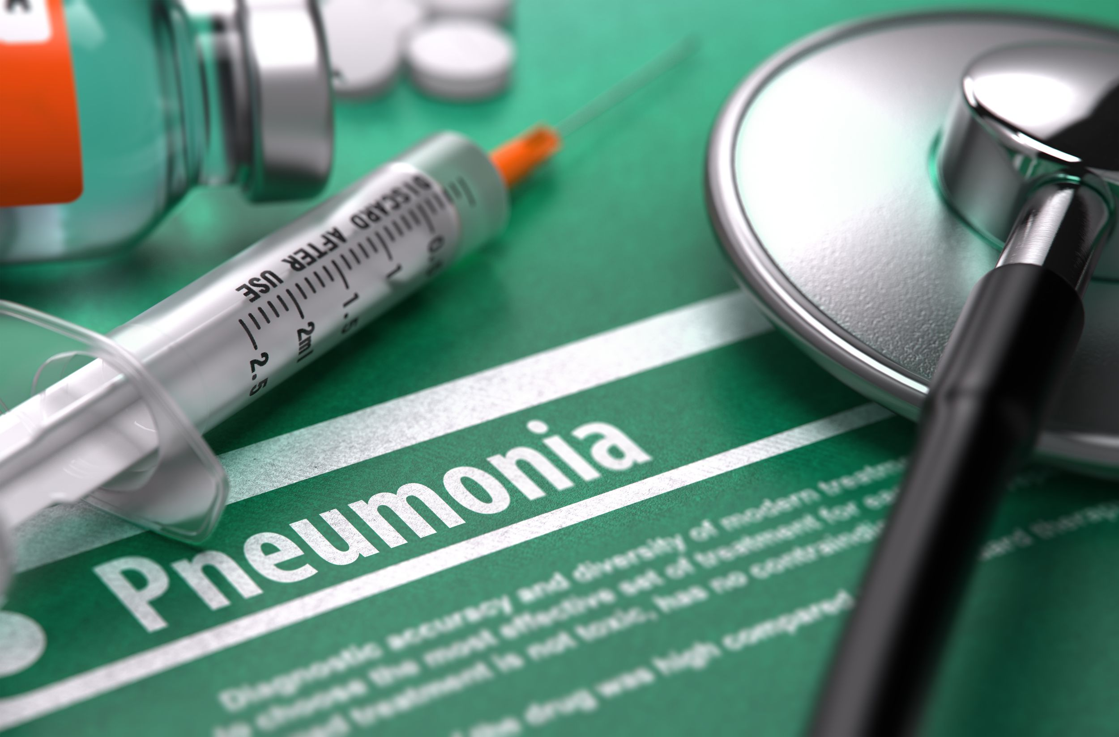
Developing a Pneumonia Disease Prediction System using CNN-based Deep Neural Network
(Machine Learning– Semester Project)
Presented By:
Ms. Fatima Zulfiqar SP20-RCS-005
Mr. Rehan Raza SP20-RCS-018
Course Taught By:
Dr. Rao Muhammad Adeel Nawab
Department of Computer Science,
COMSATS University Islamabad, Lahore Campus

Slide 3

Introduction
Proposed Technique
Experimental Setup
Results and Analysis
Conclusion and Future Work
Outline

Slide 4
Introduction

Slide 5
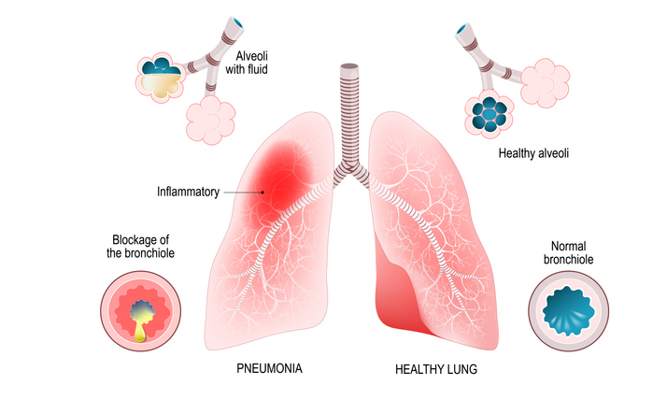
Pneumonia Disease – Definition
Pneumonia is a very infective disease that is caused by bacteria, viruses, or fungi

Slide 6

Pneumonia Disease – World Wide Death Rate
According to a recent survey conducted by World Health Organization(WHO)
Every year 700,000 children die because of Pneumonia Disease in the World

Slide 7
Pneumonia Disease – Advantages of Early Stage Diagnose
Early Stage Diagnosis of Pneumonia Disease can help
Save many Lives
Accurate Predictions Systems can help us
Diagnose Pneumonia Disease (from X-ray Images) quickly and efficiently

Slide 8
Semester Project Focus
Develop a Pneumonia Disease Prediction (from X-ray Images) System using CNN-based Deep Neural Networks

Slide 9
Pneumonia Disease Prediction (from X-ray Image) Problem – Given and Task
Given
Task
Assign a Single Label to the given X-ray Image from the pre-defined Set of Labels
An X-ray Image
2. Finite Set of Labels
(Normal and Pneumonia)

Slide 10
Pneumonia Disease Prediction (from X-ray Image) Problem – Input and Output
Input
Output
An X-ray Image (Unstructured)
Normal / Pneumonia (Categorical)

Slide 11
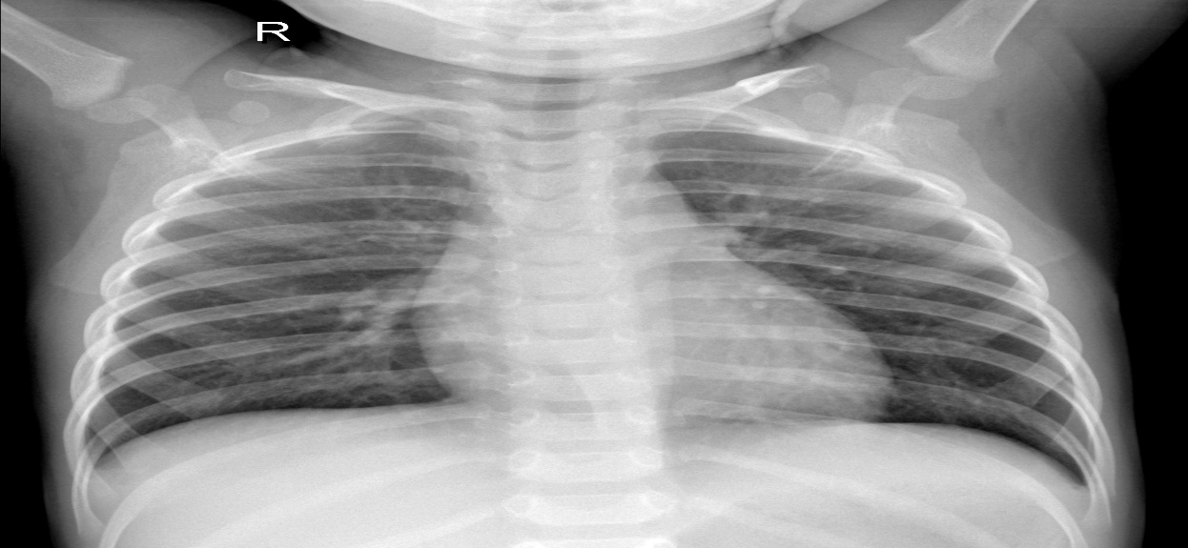
Pneumonia Disease Prediction (from X-ray Image) System – Example 01
INPUT
OUTPUT
Normal

Slide 12
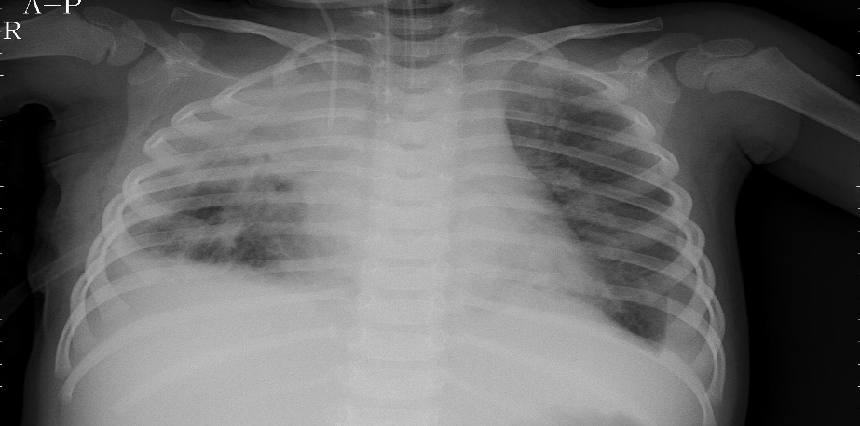
Pneumonia Disease Prediction (from X-ray Image) System – Example 02
INPUT
OUTPUT
Pneumonia

Slide 13
Proposed Technique

Slide 14
Baseline Technique
Majority Class Categorization
Majority Class Categorization is calculated by assigning the label of Majority Class to all the Test Instances
$$MCC=\frac{max⁡(Class 01, Class 02,…,Class n−1, Class n)}{Total Number of Test Instances}$$
𝑴𝑪𝑪=(𝒎𝒂𝒙⁡(𝑪𝒍𝒂𝒔𝒔 𝟎𝟏, 𝑪𝒍𝒂𝒔𝒔 𝟎𝟐,…,𝑪𝒍𝒂𝒔𝒔 𝒏−𝟏, 𝑪𝒍𝒂𝒔𝒔 𝒏))/(𝑻𝒐𝒕𝒂𝒍 𝑵𝒖𝒎𝒃𝒆𝒓 𝒐𝒇 𝑻𝒆𝒔𝒕 𝑰𝒏𝒔𝒕𝒂𝒏𝒄𝒆𝒔)

Slide 15
Proposed Technique
To develop our proposed Pneumonia Disease Prediction (from X-ray Image) System, we used
CNN-based Deep Neural Networks

Slide 16
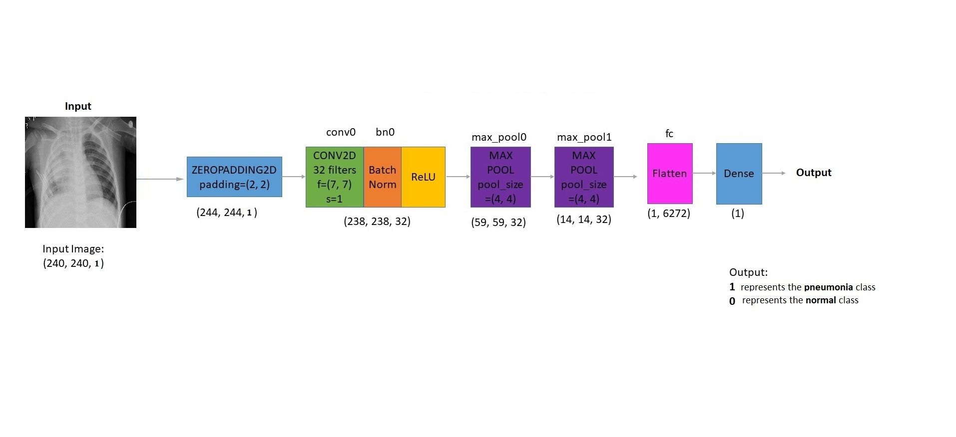
Architecture - CNN-based Deep Neural Network

Slide 17
Main Parameters - CNN-based Deep Neural Network
Parameter | Parameter Value
Input Size | (224,244,1)
No. of Hidden Layer | 2
No. of Dense Layer | 1
No. of Output Units | 1
Hidden Layer Activation Function | ReLU
Output Layer Activation Fnction | Sigmoid
No. of Epochs | 15
Learning Rate | 0.0001
Optimizer | Adam
Loss Function | binary_crossentropy

Slide 18
Experimental Setup

Slide 19
Experimental Setup
Dataset
Techniques
Evaluation Methodology
Evaluation Measures
Experimental
Setup

Slide 20
Dataset
Dataset Name
Pneumonia Disease Dataset
Dataset Download Link
https://www.kaggle.com/paultimothymooney/chest-xray-pneumonia

Slide 21
Dataset – Main Characteristics
Dataset Main Characteristics
Class | Number of Instances
Normal | 1,583 (27%)
Pneumonia | 4,273 (73%)
Total | 5,856

Slide 22
Data Split
Split Pneumonia Disease Dataset using Class Balanced Data Split Approach
Training Data
80% (4,684 instances)
Testing Data
20% (587 instances)
Validation Data
10% (585 instances)

Slide 23
Data Split Cont…
Data Split
Class | Training Set | Testing Set | Validation Set
Normal | 1,266 | 159 | 158
Pneumonia | 3,418 | 428 | 427
Total | 4,684 | 587 | 585

Slide 24
Techniques
Baseline Technique
Majority Class Categorization (MCC)
Proposed Technique
CNN-based Deep Neural Network

Slide 25
Parameters Settings – CNN-based Deep Neural Network
Parameters Settings – CNN-based Deep Neural Network
Parameter | Parameter Value
Number of Epoch | 15
Optimizer | Adam
Learning Rate | 0.0001
Loss Function | binary_crossentropy

Slide 26
System Settings – CNN-based Deep Neural Network
System Settings – CNN-based Deep Neural Network
Developer Name | Ms. Fatima Zulfiqar & Mr. Rehan Raza
Programming Language | Python 3.7.4
IDE | Google Colab Notebook
Deep Learning Toolkit | Tensorflow 2.0 Keras 2.2
Code Version | 1.0
Date | 01 – December – 2020

Slide 27
Evaluation Methodology
Pneumonia Disease Prediction Problem
Treated as Binary Classification Problem
Main Aim
Differentiate Between Two Classes
Normal
Pneumonia
Data Split Approach
Training Data = 80% (4,684 Instances)
Testing Data = 20% (587 Instances)
Validation Data = 10% of Training Data (585 Instances)

Slide 28
Evaluation Methodology Cont…
Training Data
Used to Build the Model
Validation Data
Used to Check Whether the Model is Overfitting During Training or Not?
Testing Data
Used to Evaluate the Performance of the (Trained) Model

Slide 29
Evaluation Measures
1
Accuracy
2
Precision
3
Recall
4
F₁ - measure

Slide 30
Evaluation Measures
Accuracy
Accuracy is defined as the proportion of correctly classified Test instances
Precision
Precision (P) is defined as the proportion of the predicted Positive cases that were correct
Precision = $\frac{TP}{(TP+FP ) }$
Precision = 𝑇𝑃/((𝑇𝑃+𝐹𝑃 ) )
Accuracy = $\frac{Number of Correctly Classified Test Instances}{Total Number of Test Instances}$
$$Accuracy=1−Error$$
Accuracy = (𝑁𝑢𝑚𝑏𝑒𝑟 𝑜𝑓 𝐶𝑜𝑟𝑟𝑒𝑐𝑡𝑙𝑦 𝐶𝑙𝑎𝑠𝑠𝑖𝑓𝑖𝑒𝑑 𝑇𝑒𝑠𝑡 𝐼𝑛𝑠𝑡𝑎𝑛𝑐𝑒𝑠)/(𝑇𝑜𝑡𝑎𝑙 𝑁𝑢𝑚𝑏𝑒𝑟 𝑜𝑓 𝑇𝑒𝑠𝑡 𝐼𝑛𝑠𝑡𝑎𝑛𝑐𝑒𝑠)
𝑨𝒄𝒄𝒖𝒓𝒂𝒄𝒚=𝟏−𝑬𝒓𝒓𝒐𝒓

Slide 31
Evaluation Measures Cont…
Recall
Recall (Sensitivity) is defined as the proportion of Positive cases that were correctly classified
F₁ – measure
F₁ – measure is defined as Harmonic mean of Precision and Recall, When we assign same weights to Precision and Recall i.e. β=1, then F – measure becomes F₁ – measure
$$F1−measure=2 x \frac{Precision x Recall}{(Precision +Recall ) }$$
F₁−measure=2 x (𝑃𝑟𝑒𝑐𝑖𝑠𝑖𝑜𝑛 𝑥 𝑅𝑒𝑐𝑎𝑙𝑙)/((𝑃𝑟𝑒𝑐𝑖𝑠𝑖𝑜𝑛 +𝑅𝑒𝑐𝑎𝑙𝑙 ) )
Recall = $\frac{TP}{(TN+FN)}$
Recall = 𝑇𝑃/((𝑇𝑁+𝐹𝑁))

Slide 32
Results and Analysis

Slide 33
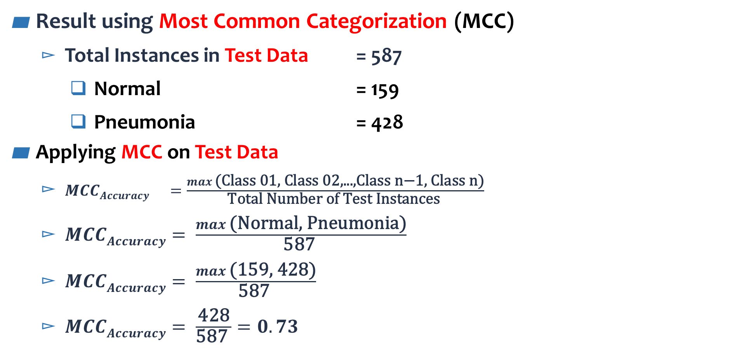
Results and Analysis
Result using Most Common Categorization (MCC)
Total Instances in Test Data = 587
Normal = 159
Pneumonia = 428
Applying MCC on Test Data
$MCCAccuracy =\frac{max \text{(}\text{Class} \text{01}\text{, }\text{Class} \text{02}\text{,...,}\text{Class} \text{n}\text{−}\text{1}\text{, }\text{Class} \text{n}\text{)}}{\text{Total} \text{Number} \text{of} \text{Test} \text{Instances} }$
$MCCAccuracy= \frac{max \text{(}\text{Normal}\text{, }\text{Pneumonia}\text{)}}{\text{587} }$
$MCCAccuracy= \frac{max \text{(}\text{159}\text{, }\text{428}\text{)}}{\text{587 }}$
$MCCAccuracy= \frac{\text{428}}{\text{587 }}=0.73$

Slide 34
Results and Analysis
Macro Average Accuracy, Precision, Recall and F₁- score are reported in Table below
Technique | Class | Accuracy | Precision | Recall | F1 – Score
MCC | Normal | - | - | - | -
 | Pneumonia | - | - | - | -
 | Macro Average | 0.73 | - | - | -
CNN | Normal | 0.99 | 0.91 | 0.99 | 0.95
 | Pneumonia | 0.96 | 1.00 | 0.96 | 0.98
 | Macro Average | 0.98 | 0.95 | 0.98 | 0.96

Slide 35
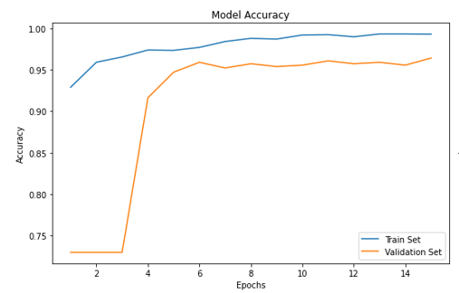
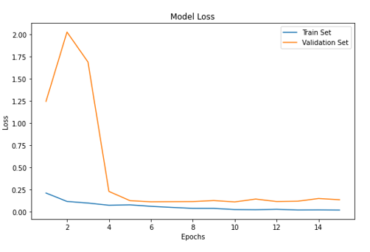
Detailed Analysis - Proposed CNN-based Deep Neural Network
Training-Validation Curve

Slide 36
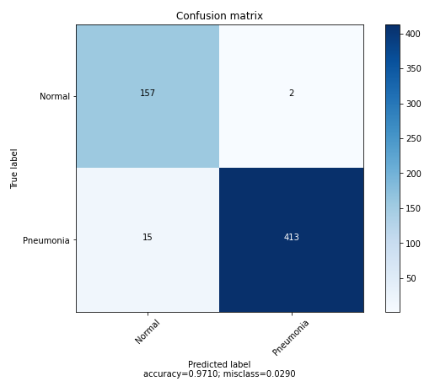
Detailed Analysis - Proposed CNN-based Deep Neural Network Cont…
Confusion Matrix

Slide 37
Conclusion and Future Work

Slide 38
Main Findings
Finding 01
Finding 02
Accuracy of CNN Model is 0.97 compared to 0.73 obtained with MCC
This Indicates a huge improvement in performance
Proposed Technique (CNN Model) outperforms the Baseline Technique (MCC)
Finding 03
Finding 04
The Most Problematic Class is Pneumonia
The performance of Proposed Technique is Improved by
Parameters Tuning

Slide 39
Conclusion
Proposed CNN-based Model performs very well in predicting Pneumonia Disease (from X-ray Images) with an Accuracy of 97%

Slide 40
Future Work
1
In Future, we plan to Increase Dataset Size
2
Explore Data Augmentation Techniques
3
Explore Other Technique including
Capsule Network
Transfer Learning

Slide 41
جزاك اللهُ خيرًا

